Slide 1

The Odyssey

Slide 2

By Homer

Slide 3
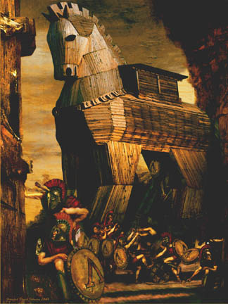
Where the Iliad ends…

Slide 4
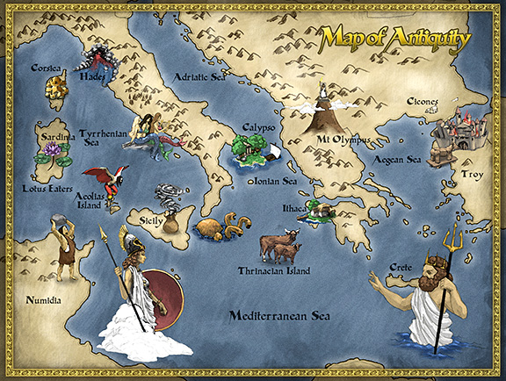
The Odyssey Begins

Slide 5
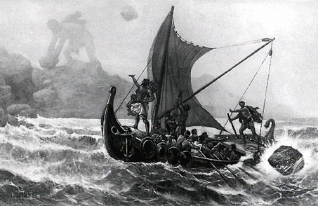

Slide 6
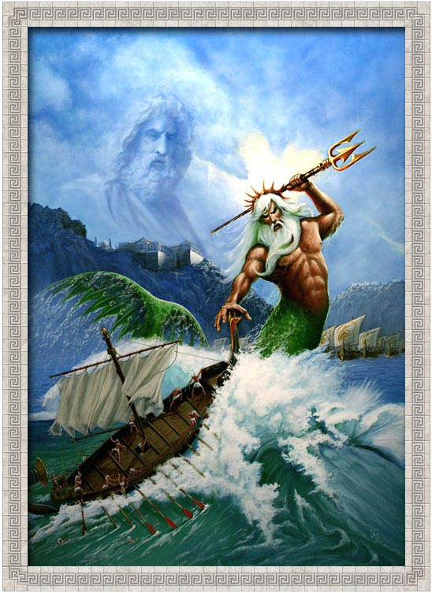
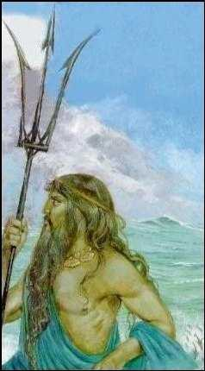

Slide 7
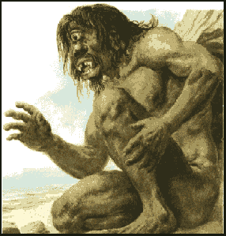
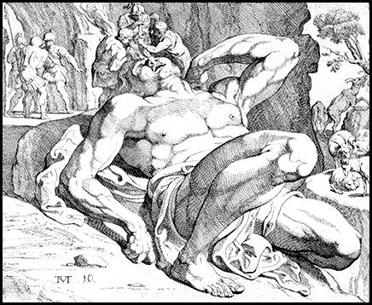
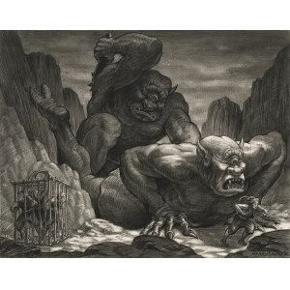
The Cyclops

Slide 8
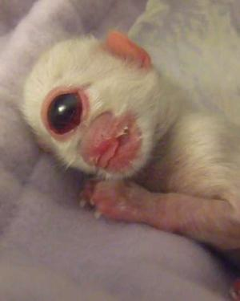
Not to be confused with…
Cyclop-
kitty!

Slide 9
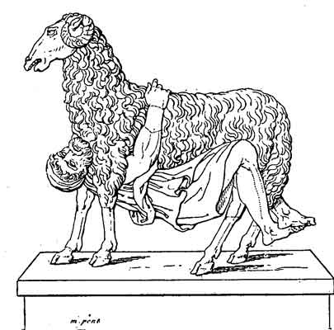
Not what you think!

Slide 10
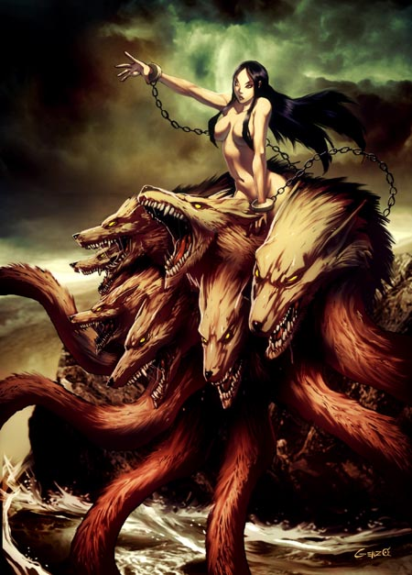
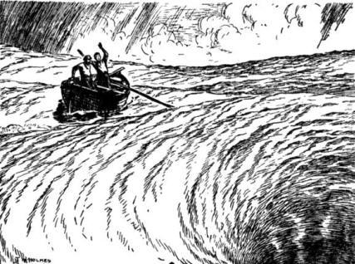

Slide 11
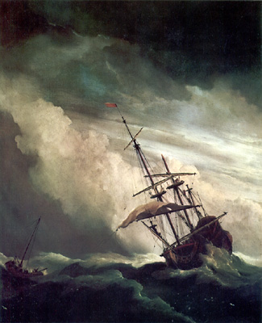

Slide 12
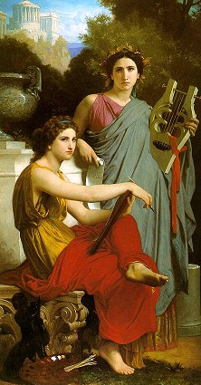
It begins with an invocation to the muse

Slide 13
The Muses
Calliope--the muse of epic poetry
Clio--the muse of history
Erato--the muse of love poetry
Euterpe--the muse of lyric poetry
Melpomene--the muse of tragedy
Polyhymnia--the muse of songs of praise to the gods
Terpsichore--the muse of choral songs and dance
Thalia--the muse of comedy
Urania--the muse of astronomy

Slide 14
"Sing to me of the man, Muse, the man of twists and turns
driven time and again off course, once he had plundered
the hallowed heights of Troy.
"Many cities of men he saw and learned their minds,
many pains he suffered, heartsick on the open sea,
fighting to save his life and bring his comrades home.
But he could not save them from disaster, hard as he strove -
the recklessness of their own ways destroyed them all,
the blind fools, they devoured the cattle of the Sun
and the Sun god blotted out the day of their return.
"Launch out on his story, Muse, daughter of Zeus,
start from where you will - sing for our time too."

